Slide 1
Unsupervised Learning: Word Embedding
Notes:
Preparing the demo
Extra topic:
maybe I can talk about relation extraction
Rest:
Paragraph vector
Introducing document vector
convolutional DSSM or parsing tree
Introducing the whole representation
Topic covered:
Motivation: meaning representation
Meaning of one word:
predict the next word
structure
How to train 1
why? What we get (done)
other structure 1
Meaning of a sentence:
Deep Semantic 1
+ convolution 1
Paragraph Vector 1
Outlook: parsing, composition

Slide 2
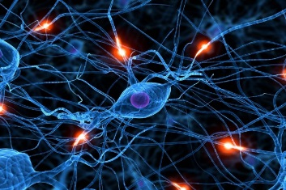

Word Embedding
Machine learns the meaning of words from reading a lot of documents without supervision
Word Embedding
tree
flower
dog
rabbit
run
jump
cat

Slide 3
1-of-N Encoding
Word Embedding
apple = [ 1 0 0 0 0]
dog
bag = [ 0 1 0 0 0]
rabbit
run
cat = [ 0 0 1 0 0]
jump
cat
dog = [ 0 0 0 1 0]
tree
flower
elephant = [ 0 0 0 0 1]
Word Class
class 1
Class 2
Class 3
dog
ran
flower
cat
jumped
bird
walk
tree
apple

Slide 4
Word Embedding
Machine learns the meaning of words from reading a lot of documents without supervision
A word can be understood by its context
You shall know a word by the company it keeps
蔡英文、馬英九 are something very similar
馬英九 520宣誓就職
蔡英文 520宣誓就職

Slide 5
How to exploit the context?
Count based
If two words w_{i} and w_{j} frequently co-occur, V(w_{i}) and V(w_{j}) would be close to each other
E.g. Glove Vector: http://nlp.stanford.edu/projects/glove/
Prediction based
V(w_{i}) . V(w_{j})
N_{i,j}
Inner product
Number of times w_{i} and w_{j} in the same document

Slide 6
Prediction-based – Training
潮水
Neural
Network
就
Collect data:
退了
潮水 退了 就 知道 誰 …
不爽 不要 買 …
公道價 八萬 一 …
………
退了
Neural
Network
知道
就
Minimizing cross entropy
就
Neural
Network
誰
知道
Notes:
What can it do? Application?

Slide 7
Prediction-based - 推文接話
推 louisee :話說十幾年前我念公立國中時,老師也曾做過這種事,但
推 pttnowash :後來老師被我們出草了
→ louisee :沒有送這麼多次,而且老師沒發通知單。另外，家長送
→ pttnowash :老師上彩虹橋 血祭祖靈
https://www.ptt.cc/bbs/Teacher/M.1317226791.A.558.html
推 AO56789: 我同學才扯好不好，他有一次要交家政料理報告
→ AO56789:其中一個是要寫一樣水煮料理的食譜，他居然給我寫
→ linger:溫水煮青蛙
→ AO56789:溫水煮青蛙，還附上完整實驗步驟，老師直接給他打0
→ linger:幹還真的是溫水煮青蛙
著名簽名檔 (出處不詳)
Notes:
故意接樓上推文來裱樓上

Slide 8
Prediction-based – Language Modeling
P(“wreck a nice beach”)
=P(wreck|START)P(a|wreck)P(nice|a)P(beach|nice)
P(b|a): the probability of NN predicting the next word.
P(next word is “wreck”)
P(next word is “a”)
P(next word is “nice”)
P(next word is “beach”)
Neural
Network
Neural
Network
Neural
Network
Neural
Network
1-of-N encoding of “START”
1-of-N encoding of “wreck”
1-of-N encoding of “a”
1-of-N encoding of “nice”

Slide 9
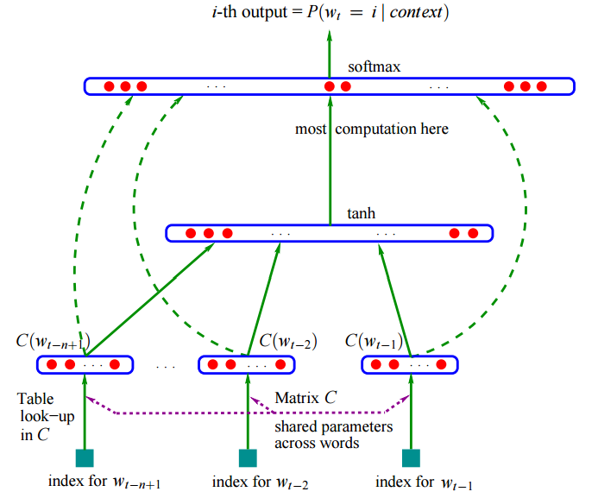
Bengio, Y., Ducharme, R., Vincent, P., & Jauvin, C. (2003). A neural probabilistic language model. Journal of machine learning research, 3(Feb), 1137-1155.

Slide 10
Prediction-based
w_{i}
…… w_{i-2} w_{i-1} ___
0
z₁
1-of-N encoding
of the word w_{i-1}
1
z₂
The probability for each word as the next word w_{i}
0
……
……
…
……
Take out the input of the neurons in the first layer
z₂
tree
flower
Use it to represent a word w
dog
rabbit
run
jump
cat
Word vector, word embedding feature: V(w)
z₁
Notes:
Note that we only consider one input word, we only consider wi-1
We will consider multiple word
The structured is a little different

Slide 11
Prediction-based
You shall know a word by the company it keeps
0
z₁
1
z₂
The probability for each word as the next word w_{i}
0
……
……
蔡英文
or
馬英九
…
……
“宣誓就職” should have large probability
Training text:
z₂
…… 蔡英文 宣誓就職 ……
蔡英文
w_{i-1}
w_{i}
馬英九
…… 馬英九 宣誓就職 ……
w_{i-1}
w_{i}
z₁
Notes:
A man is known by the company he keeps.
觀其友知其人
Why the word vectors can probably capture the meaning of the words

Slide 12
Prediction-based – Sharing Parameters
0
z₁
1-of-N encoding
of the word w_{i-2}
1
W₁
z₂
The probability for each word as the next word w_{i}
0
……
……
…
z
x_{i-2}
0
The length of x_{i-1} and x_{i-2} are both |V|.
1-of-N encoding
of the word w_{i-1}
W₂
The length of z is |Z|.
1
z = W₁ x_{i-2} + W₂ x_{i-1}
0
……
The weight matrix W₁ and W₂ are both |Z|X|V| matrices.
x_{i-1}
z = W ( x_{i-2} + x_{i-1} )
W₁ = W₂
= W
Notes:
Should I describe it more clearly?
Can consider longer history

Slide 13
Prediction-based – Sharing Parameters
0
z₁
1-of-N encoding
of the word w_{i-2}
1
z₂
The probability for each word as the next word w_{i}
0
……
……
…
0
The weights with the same color should be the same.
1-of-N encoding
of the word w_{i-1}
0
1
……
Or, one word would have two word vectors.
Notes:
Should I describe it more clearly?

Slide 14
Prediction-based – Various Architectures
Continuous bag of word (CBOW) model
Skip-gram
w_{i-1}
Neural
Network
…… w_{i-1} ____ w_{i+1} ……
w_{i}
w_{i+1}
predicting the word given its context
…… ____ w_{i} ____ ……
Neural
Network
w_{i-1}
w_{i}
w_{i+1}
predicting the context given a word

Slide 15
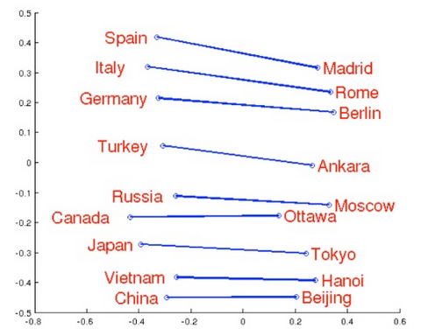
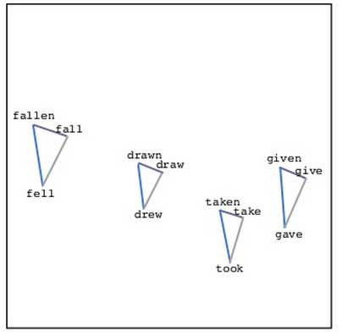
Word Embedding
Source: http://www.slideshare.net/hustwj/cikm-keynotenov2014
Notes:
Why can it happen
How to explain it

Slide 16
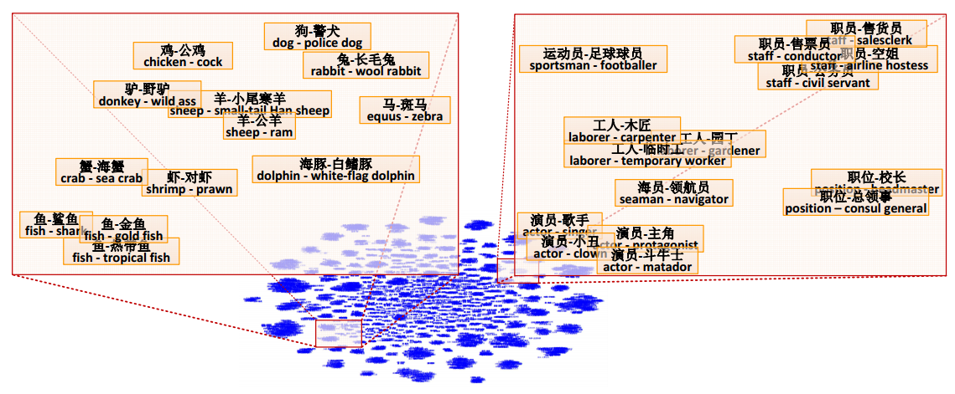
Word Embedding
Fu, Ruiji, et al. "Learning semantic hierarchies via word embeddings."Proceedings of the 52th Annual Meeting of the Association for Computational Linguistics: Long Papers. Vol. 1. 2014.

Slide 17
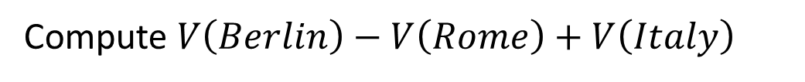
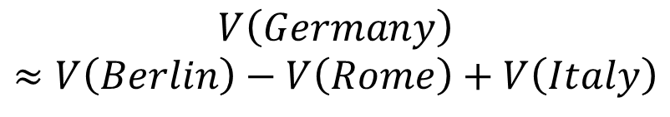
Word Embedding
$$V\left(Germany\right)$$
$$≈V\left(Berlin\right)−V\left(Rome\right)+V\left(Italy\right)$$
Characteristics
Solving analogies
$$V\left(hotter\right)−V\left(hot\right)≈V\left(bigger\right)−V\left(big\right)$$
$$V\left(Rome\right)−V\left(Italy\right)≈V\left(Berlin\right)−V\left(Germany\right)$$
$$V\left(king\right)−V\left(queen\right)≈V\left(uncle\right)−V\left(aunt\right)$$
Rome : Italy = Berlin : ?
Compute $V\left(Berlin\right)−V\left(Rome\right)+V\left(Italy\right)$
Find the word w with the closest V(w)
Notes:
Hierarchy is not mentioned …

Slide 18

Demo
Machine learns the meaning of words from reading a lot of documents without supervision
Notes:
Machine learns to understand 鄉民用語 via reading the posts on PTT

Slide 19
Demo
Model used in demo is provided by 陳仰德
Part of the project done by 陳仰德、林資偉
TA: 劉元銘
Training data is from PTT (collected by 葉青峰)
Notes:
http://140.112.21.35:2880/~tlkagk/Word2Vec/
魯夫 海賊王 鳴人
大學生 專題研究 忍者 忍術
大學生 專題研究 漫畫家 作品
天 地 溫拿 魯蛇
天 地 營養學分 專業課
忍者 查克拉 獵人 生命能量
忍者 查克拉 魯夫 橡膠果實
研究生 期刊 漫畫家
研究生 做實驗 漫畫家
魯蛇 窮 溫拿
肥宅 八嘎囧 本魯
魯夫 海賊王 鳴人
魯蛇 loser 溫拿
魯蛇 窮 溫拿
研究生 期刊 漫畫家
本魯 廢宅 好棒 好棒棒
魯蛇 窮 溫拿
天 地 溫拿 魯蛇
天 地 專業課
研究生 期刊 漫畫家
找最相近詞: 廢宅 本魯 宅宅 好棒 好棒棒 魯夫 李逍遙 御坂美琴
A:B = C:?
魯夫 海賊王 鳴人
大學生 專題研究 忍者 忍術
大學生 專題研究 漫畫家 作品
天 地 溫拿 魯蛇
天 地 營養學分 專業課
忍者 查克拉 獵人 生命能量
忍者 查克拉 魯夫 橡膠果實
研究生 做實驗 漫畫家
魯夫 海賊王 鳴人
魯蛇 窮 溫拿

Slide 20
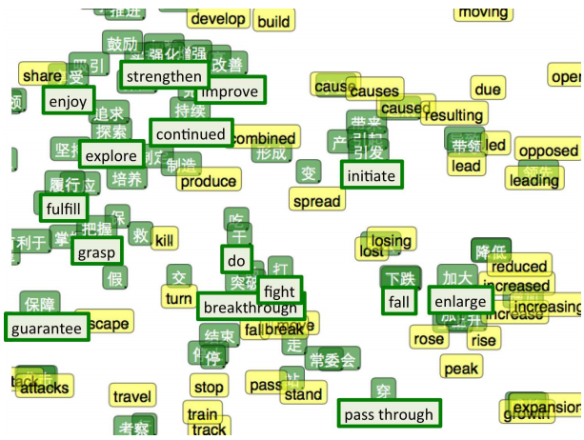
Multi-lingual Embedding
Bilingual Word Embeddings for Phrase-Based Machine Translation, Will Zou, Richard Socher, Daniel Cer and Christopher Manning, EMNLP, 2013
Notes:
Intuitively, it feels a bit like the two languages have a similar ‘shape’ and that by forcing them to line up at different points, they overlap and other points get pulled into the right positions.
草泥馬
河蟹
菸酒生
忍者 查克拉 獵人 生命能量
忍者 查克拉 魯夫 橡膠果實
研究生 做實驗 漫畫家
研究生 期刊 漫畫家

Slide 21

Document Embedding
word sequences with different lengths → the vector with the same length
The vector representing the meaning of the word sequence
A word sequence can be a document or a paragraph
…
word sequence
(a document or paragraph)
Notes:
The meaning of word is ambiguous
It can be easy for a document

Slide 22
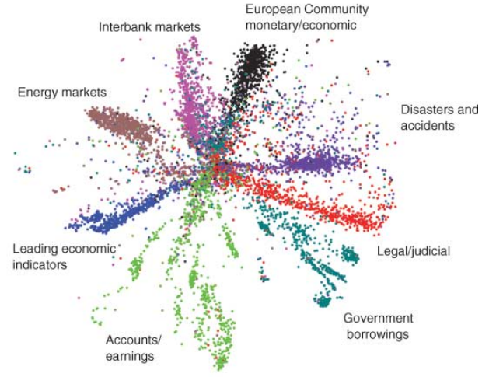
Semantic Embedding
Reference: Hinton, Geoffrey E., and Ruslan R. Salakhutdinov. "Reducing the dimensionality of data with neural networks." Science 313.5786 (2006): 504-507
Bag-of-word
Notes:
Auto-encoder is another approach
The qeruy not always have the common word

Slide 23
Beyond Bag of Word
To understand the meaning of a word sequence, the order of the words can not be ignored.
white blood cells destroying an infection
positive
different
meaning
exactly the same bag-of-word
an infection destroying white blood cells
negative
Notes:
傳染病 infection
http://ezchatbox.ml/
需要找好例子

Slide 24
Beyond Bag of Word
Paragraph Vector: Le, Quoc, and Tomas Mikolov. "Distributed Representations of Sentences and Documents.“ ICML, 2014
Seq2seq Auto-encoder: Li, Jiwei, Minh-Thang Luong, and Dan Jurafsky. "A hierarchical neural autoencoder for paragraphs and documents." arXiv preprint, 2015
Skip Thought: Ryan Kiros, Yukun Zhu, Ruslan Salakhutdinov, Richard S. Zemel, Antonio Torralba, Raquel Urtasun, Sanja Fidler, “Skip-Thought Vectors” arXiv preprint, 2015.
Notes:
word2vec 中的數學原理詳解（一）目錄和前言
http://blog.csdn.net/itplus/article/details/37969519

Slide 25
Acknowledgement
感謝 John Chou 發現投影片上的錯字

